Slide 1
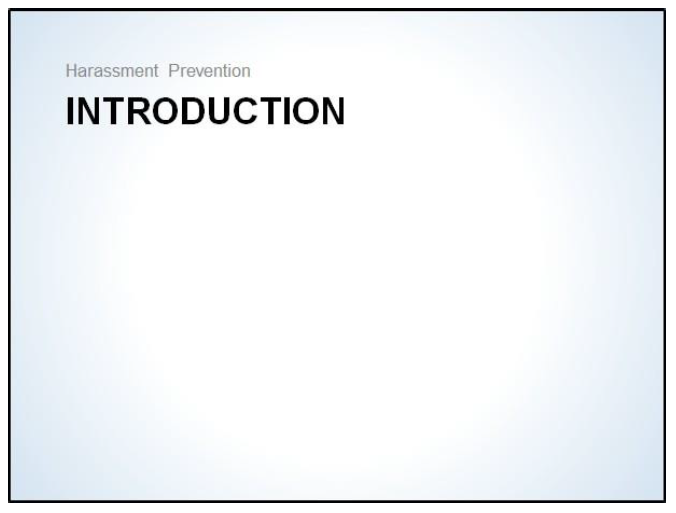

Slide 2
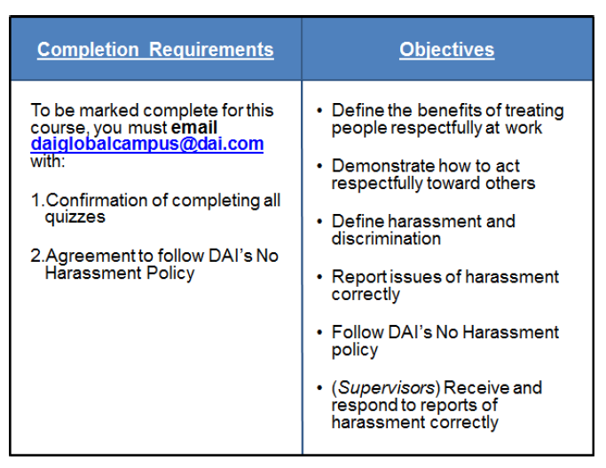
Notes:
This workbook is a substitute for the online Harassment Prevention courses. It can be used by those with computer or Internet bandwidth issues. It covers the same objectives as the online courses in an easy- to-complete format.
• All employees must complete Sections 1, 2, and 3 of this workbook.
• All supervisors (anyone who has at least one employee directly reporting to them) are responsible for completing Section 4 – Reporting.
• All employees are responsible for reading and acknowledging DAI’s No Harassment policy, which is found in the Operations Manual.
You’ll also find quizzes within each section of this workbook. Please complete these quizzes on your own without any assistance from sources outside of this workbook. These are self-graded quizzes, and you will use the answer key provided separately to check your answers.
To be marked complete for this course, you will need to submit a Statement of Harassment Prevention Completion by email to iLearn@dai.com. This statement, which is included on Page 31 of this workbook, confirms your completion of these quizzes and agreement to follow the No Harassment policy.

Slide 3
After completing this training, you will be able to:
• Define the benefits of treating people respectfully at work
• Demonstrate how to act respectfully to others
• Define harassment and discrimination
• Report issues of harassment correctly
• Follow DAI’s No Harassment policy
• (Supervisors) Receive and respond to reports of harassment correctly

Slide 4
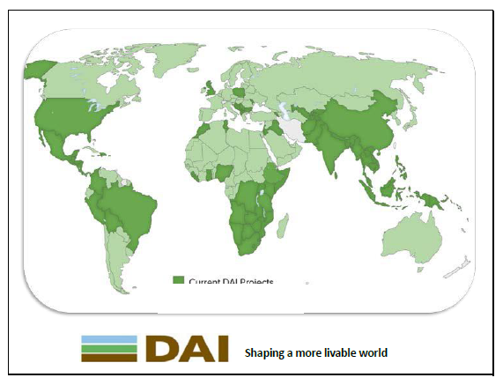
A Global Workplace
Staff in over 80 countries, across multiple environments, cultures, and backgrounds
Demonstrating respect toward one another is critical when working in a global company
We expect everyone to be respectful and create a positive work environment for their colleagues, clients, and beneficiaries

Slide 5

Working in a Global Workplace
Notes:
Working in a global workplace can be challenging. In a geographically and culturally diverse workforce, there is greater opportunity for misunderstandings to occur. Differences in each office, such as varying local labor laws, can add to these challenges as well. Despite the challenges, we can all work productively and feel safe if we treat each other with respect. Everyone is responsible for maintaining a respectful work environment.

Slide 6
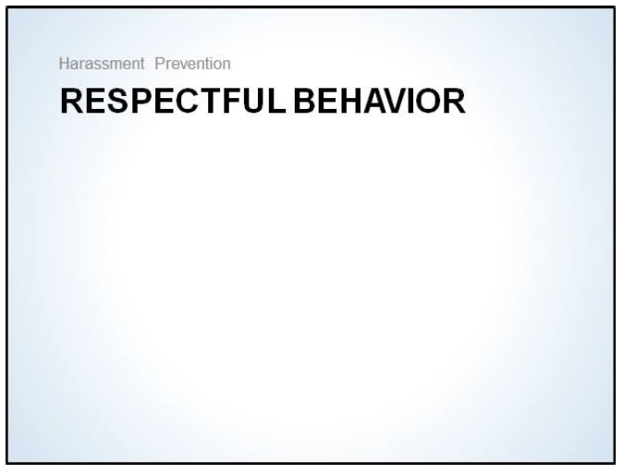

Slide 7

A Respectful Workplace
When co-workers offend, embarrass, or disrespect each other, they can damage working relationships, lower productivity, and increase employee turnover. Some forms of disrespect are considered illegal harassment in most countries. Other forms of disrespect may not be illegal, but are not tolerated at DAI.

Slide 8
A respectful workplace is everyone’s responsibility and in everyone’s best interest. Demonstrating respect for your colleagues shows that you value their contributions and perspectives, and helps build positive professional relationships. A respectful workplace also:
• Supports employee well-being and high morale
• Facilitates a productive work environment
• Facilitates constructive communication for solving problems
• Lends to fewer misunderstandings

Slide 9
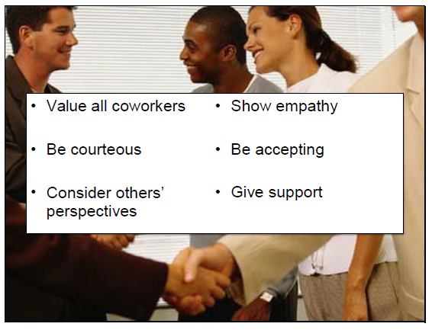
Demonstrating Respect
Notes:
Your behavior plays a significant role in maintaining a respectful work place. There are some basic principles you should follow to ensure a respectful work place for you and your colleagues.
• Value all your coworkers
Appreciate various talents, skills, and perspectives that each individual brings to the organization.
• Be courteous
Show common courtesy through verbal (ex. – greetings, politeness) and non-verbal (ex. – smiling, personal space) communication.
• Consider perspectives of others
Others may view situations differently than you. Be considerate of alternate viewpoints.
• Show empathy
Try to identify with the perspectives of your co-workers despite your differences.
• Be accepting
Accept your co-workers for who they are and embrace their differences.
• Give Support
Let your co-workers know that you appreciate them. Be willing to assist them if help is needed.

Slide 10
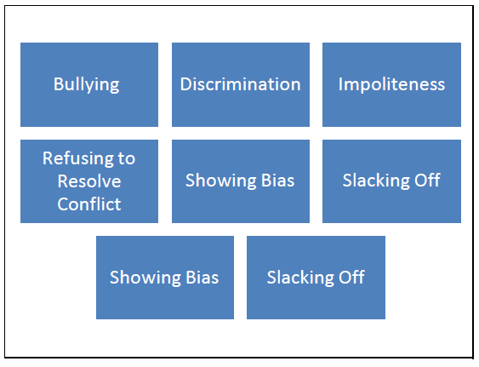
Examples of Disrespectful Behavior
Disrespectful behavior has very negative effects in the workplace. Employees who are rude, vulgar or who make condescending remarks to others can significantly diminish office morale. Everyone deserves to work in a positive, respectful workplace.
Stereotyping
Undermining

Slide 11
Examples of Disrespectful Behavior
Bullies use aggressive behavior and intimidation, which creates a hostile work environment.
Stereotyping
Undermining

Slide 12
Examples of Disrespectful Behavior
Discrimination is an action that denies participation or human rights to someone based on prejudice. Discriminating against someone is not only disrespectful to the person the behavior is directed toward, but also to others who witness the behavior.
Stereotyping
Undermining

Slide 13
Examples of Disrespectful Behavior
Impolite behavior can be verbal or non-verbal, including rude communication (sarcasm, slurs, or yelling) or social exclusion (shunning or isolating coworkers). .
Stereotyping
Undermining

Slide 14
Examples of Disrespectful Behavior
Conflict resolution is key in the workplace. Failing to immediately deal with conflicts is harmful. Walking away from a conversation is a form of disrespectful behavior.
Stereotyping
Undermining

Slide 15
Examples of Disrespectful Behavior
Issuing slurs or statements in the workplace that suggest bias is disrespectful. Bias can be found in the decisions and actions of a person when they are based solely on the gender, race, age group, or culture of other people.
Stereotyping
Undermining

Slide 16
Examples of Disrespectful Behavior
When someone doesn’t do their part, others inevitably will have to pick up their slack. Showing up late or unprepared forces colleagues to take on extra work on behalf of the one who is slacking off.
Stereotyping
Undermining

Slide 17
Examples of Disrespectful Behavior
Stereotypes are assumptions people make about the traits of members of a group. Stereotypes of people from other places can be a barrier to communication in the workplace.
Stereotyping
Undermining

Slide 18
Examples of Disrespectful Behavior
Making disparaging comments about an employees work product, or refusing to assist a coworker in completing their work, to lower their perceived value by co-workers or supervisors are all examples of undermining.
Stereotyping
Undermining

Slide 19
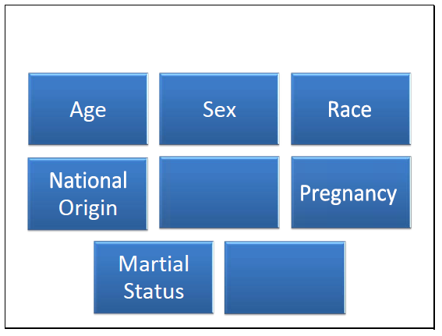
Discrimination
Acting on prejudicial views and stereotypes is discriminatory behavior. Most countries have laws which prohibit discrimination on these characteristics (left). Regardless of your country’s laws, discrimination is not acceptable at DAI and is grounds for disciplinary action and potentially termination.
Religion
Disability

Slide 20
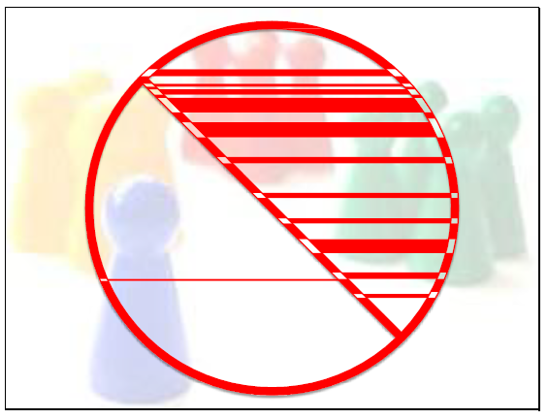
Stereotyping
Stereotypes are assumptions people make about the traits of members of a group. Stereotyping can downplay a person’s uniqueness and reinforce superficial judgments that others may make before getting to know the person. To ensure we have a respectful workplace, some co-workers will need to overcome conscious and sub-conscious prejudices. Prejudices can be connected to stereotyping based on a person’s cultural background or personal characteristics. Although colleagues may not be conscious of it, stereotyping should never be exhibited in the workplace.

Slide 21
QUIZ
1. Which characteristics below are viewed as forms of discrimination in most countries? (Select all that apply)
a. Age
b. Occupation
c. Sex
d. Religion
e. Disability
f. Attire
g. Marital status
h. Pregnancy
i. National origin
j. Political affiliation

Slide 22
2. Amir and Sari had an argument a week ago about the formatting used in a report they created for a client. Since then, Amir tried to get coffee with Sari and talk about the argument more calmly. Each time Sari has avoided speaking with Amir entirely. Others in the office have noticed the hostility between the two. What type of disrespectful behavior is illustrated in this example?
a. Stereotyping
b. Slacking off
c. Refusing to resolve conflict
d. Discrimination

Slide 23
3. What are some specific benefits of a respectful workplace for employees? (Select all that apply)
a. Supports employee well-being and high morale
b. Makes employees feel undervalued
c. Facilitates a more productive work environment
d. Facilitates constructive communication for solving problems
e. Lends to fewer misunderstanding
f. Discourages employee involvement

Slide 24
4. Amina was recently promoted to supervise six new employees. The employees are friendly with one another and often socialize outside of work. During an office party to celebrate her promotion, one of the employees decided to tell a couple of jokes about Muslims. One employee is visibly upset by the jokes and abruptly leaves the party. What type of disrespectful behavior is illustrated in this example?
a. Discrimination
b. Stereotyping
c. Bullying
d. Undermining

Slide 25
5. Select the most common and harmful forms of disrespect in the global workplace? (Select all that apply)
a. Undermining
b. Showing bias
c. Discrimination
d. Stereotyping
e. Slacking off
f. Bullying

Slide 26
6. Maria’s coworker Omar often yells at her in front of their colleagues during monthly staff meetings. Anytime Maria has an idea to contribute to the group Omar belittles her opinions. Omar’s behavior makes Maria feel intimidated and humiliated. What type of disrespectful behavior is illustrated in this example?
a. Bullying
b. Refusing to resolve conflict
c. Discrimination
d. Showing bias

Slide 27
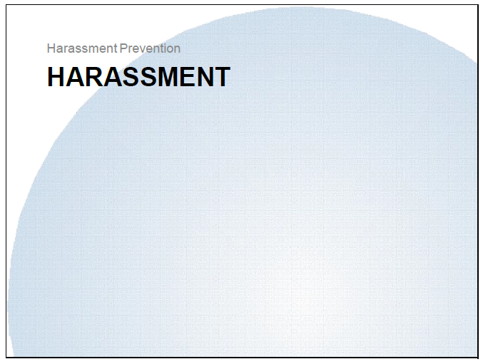

Slide 28
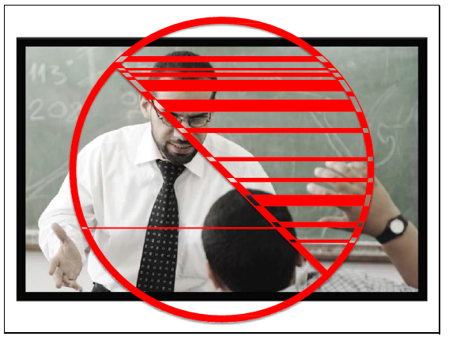
Harrassment
Harassment can quickly destroy a respectful work environment. No one should be subject to harassment of any kind at DAI.
Note that harassment is against the law in most countries around the world. Although local laws differ slightly in detail, DAI’s No Harassment Policy specifies that no harassment of any kind will be tolerated. We implement this same policy in all offices in every country to ensure maximum safety, morale, and productivity at work. Regardless of where you work, you are equally protected against harassment.

Slide 29
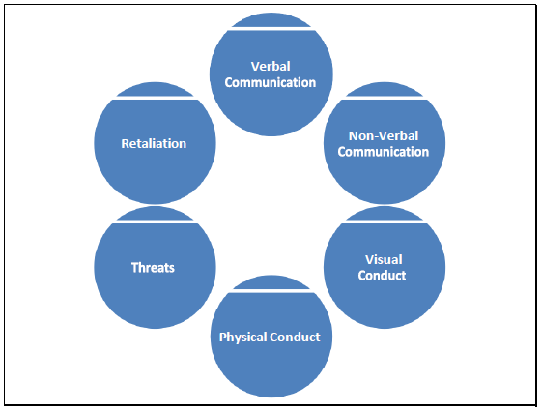
Types of Harassment
Verbal or written conduct (including emails) such as epithets, jokes or comments that are sexual in nature, sexist or derogatory, slurs or unwanted advances, invitations or comment

Slide 30
Types of Harassment
Visual conduct such as derogatory and/or sexually oriented screen savers, posters, photography, cartoons, drawing or gestures

Slide 31
Types of Harassment
Physical conduct such as assault, touching, restraining, blocking normal movement or any physical interference with work

Slide 32
Types of Harassment
Threats and demands to submit to certain non-work related conduct or perform certain non- work activities

Slide 33
Types of Harassment
Retaliation by any of the above means for having reported, threatened to report or having assisted another employee to report harassment or discrimination

Slide 34

Reporting Harassment

Slide 35
Reporting Harassment
Everyone has a right to work in a respectful, harassment-free environment. If you believe that you are being harassed, appropriately ask the individual to stop. By speaking about the issue directly with the harasser, you are stating that their behavior is offensive to you. Sometimes, the offenders are unaware when their own behavior is offensive to others, and will gladly stop once it is acknowledged.
In some cases, you may be too uncomfortable to ask the offender to stop their behavior. Or, you may have already asked them to stop, but it has continued. In these cases, report the incident immediately so the behavior can be addressed appropriately.
Likewise, it is your responsibility to report any harassment or discrimination you may witness, even if it does not involve you. DAI relies on everyone to create an environment of trust and respect in the office. We should all do our part by speaking up for co-workers who may need our help.
With all reports, confidentiality will be maintained as much as possible, consistent with existing laws and the need to conduct an adequate review. When warranted, prompt and appropriate corrective actions will be taken. DAI will never retaliate against any employee for filing a report, nor will not tolerate retaliation by co-workers, consultants, or vendors. You should always feel safe to report any harassment issues.

Slide 36

Reporting Options

Slide 37
Reporting Options
When you need to report harassment, DAI encourages you to talk to your direct supervisor first. If you are unable to speak with your supervisor, or uncomfortable doing so, you can always report incidents to one of the following resources:
• You may always contact Human Resources to report harassment.
• DAI’s Senior Vice President of Human Resources
• Any member of Human Resources Management Team
• You can also contact DAI’s Chief Ethics and Compliance Officer at ethics@dai.com.
• Additionally, you can submit reports to our secure Ethics and Compliance website: https://secure.ethicspoint.com/domain/media/en/gui/34333/index.html
(Choose "File a New Report," select a Country, and file your report)
• For complete anonymity, you may also call DAI’s Anonymous Hotline to report issues:
• +1-855-603-6987 (US – Toll-free)
• +1-503-597-4328 (International - Reverse charges or call collect)

Slide 38
Harassment Quiz
DAI’s No Harassment Policy does not tolerate harassment of any kind.
True / False

Slide 39
2. When co-workers offend, embarrass or disrespect each other they can: (Select all that apply)
a. Improve employee morale
b. Lower productivity
c. Increase employee turnover
d. Damage working relationships

Slide 40
3. Where can you locate information on DAI’s No Harassment Policy?
a. Oracle
b. Operations Manual
c. Lotus Notes

Slide 41
4. What is the first thing you should do if you have been harassed or witness harassment?
a. Talk to your direct supervisor first
b. Confront the individual who’s harassing you if you feel comfortable doing so
c. Ignore the harassment hoping it won’t happen again
d. Retaliate against the individual causing the harassment

Slide 42
5. If you are unable to speak with your supervisor, or uncomfortable doing so, you can always report incidents of harassment to one of the following resources.
(Select all that apply)
a. Human Resources
b. DAI’s Chief Ethics and Compliance Officer at ethics@dai.com.
c. Global Security
d. Ethics and Compliance website
e. DAI’s Anonymous Hotline
f. Oracle

Slide 43
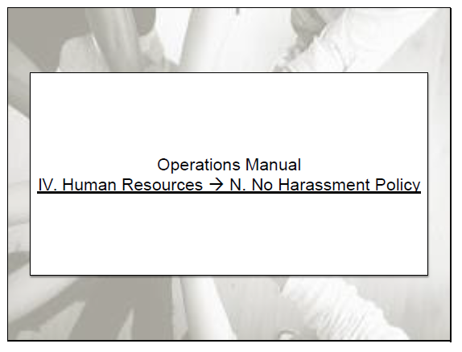
No Harassment Policy

Slide 44
No Harassment Policy
DAI’s No Harassment policy outlines the company’s expectations for employee’s behavior. The harassment policy also includes guidelines on reporting inappropriate behavior and identifies where you can go with any questions or concerns.
Please read DAI’s No Harassment policy in the Operations Manual
After you’ve finished this course, you must also acknowledge this policy. Page 31 of the workbook includes the Statement of Harassment Prevention Completion.

Slide 45

Supervisor Responsibilities
At all times, a supervisor must conduct themselves in a manner that reflects DAI’s expectations of civility and respect. As well as creating an environment where people are comfortable to come talk to you about challenges they face.
Supervisors set the tone by demonstrating respectful behavior. You are the standards around which employees will model their own behaviors.

Slide 46
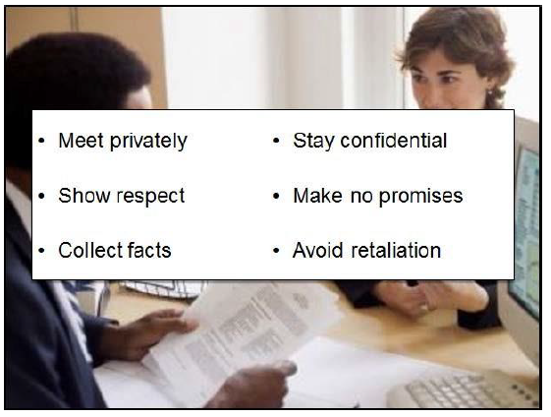
Receiving Reports from Employees
Notes:
If an employee raises a potential harassment issue with you, it is your responsibility as the supervisor to respond to the incident as quickly as possible. You’ll need to actively listen to the employee to decide if the issue needs to be addressed.
As you listen to the employee’s issue, remember to:
• Meet privately with employee
Don’t arouse the suspicions of other employees. The reporting employee should feel safe and comfortable in discussing the issue.
• Show respect to the employee
Thank the employee for being brave by discussing the issue with you. Give him/her your full attention, and avoid non-emergency interruptions.
• Collect the facts
Get as many details as possible from the reporting employee. This will help you assess what occurred.
• Stay as confidential as possible
If you need to investigate the issue further, do as much as you can to keep the reporting employee’s name hidden.
• Make no promises to the employee
You should not promise any specific results to the employee immediately. You may need to investigate more thoroughly.
• Avoid retaliation
DAI has a strict “no retaliation” policy. An employee should never face consequences for honestly reporting harassment.

Slide 47
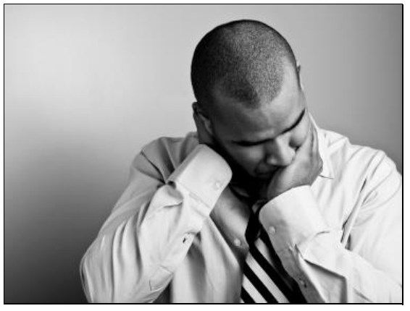
Addressing Harassment
When you receive a report of harassment, you’ll need to collect as many facts as possible from the reporting employee. You may also need to conduct investigations to uncover additional information.
All of the information you gather will help you decide if an incident of harassment actually occurred. Use DAI’s No Harassment policy, as well as what you’ve learned in this workbook, to make that determination.
Harassment should be dealt with swiftly and severely. If you conclude that harassment occurred, you must immediately contact a member of the Human Resources Management Team. Human Resources will undertake appropriate follow-up action on the issue.

Slide 48
Supervisor Roles Quiz
At all times, a supervisor must conduct themselves in a manner that reflects DAI’s expectations of civility and respect.
True / False

Slide 49
2. If an employee raises a potential harassment issue with you, it is your responsibility as the supervisor to respond to the incident _.
(Fill in the blank)
a. when you have time
b. within 48 hours
c. as quickly as possible
d. when the employee has sufficient evidence of the harassment

Slide 50
3. When actively listening to an employee’s issue, you should remember to: (Select all that apply)
a. Ask employee to collect evidence
b. Show respect and meet privately with employee
c. Collect all the facts and stay as confidential as possible
d. Make no promises to the employee about any specific results
e. Avoid retaliation
f. Call for a meeting with all parties involved to examine the issue

Slide 51
4. Yosef comes to his supervisor after overhearing co-workers make age-biased comments about him. During the meeting with his supervisor, Yosef also mentions that he is being teased about his age by Jacob. Whenever he asks Jacob a question, Jacob will respond with age discriminating comments. What resource (s) should the supervisor use to help determine if an incident of harassment actually occurred?
(Select all that apply)
a. DAI’s No Harassment policy
b. what you’ve learned in this workbook
c. statements from the other employees
d. Yosef’s statement is all the proof you need
e. DAI Global Human Resource Team

Slide 52
5. If you conclude that harassment occurred, you must immediately contact . (Fill in the blank)
a. a member of the Human Resources Management Team
b. the accused
c. the client
d. all employees involved and have a group meeting
e. no one, allow the problem to work itself out

Slide 53
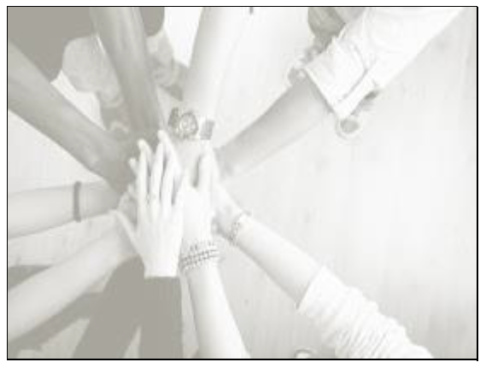
Conclusion
A respectful workplace is one where all employees are valued, communication is courteous and interaction between individuals is supportive. As a manager, it is your responsibility to recognize and deal swiftly with any instances of disrespect, harassment, bullying or any other form of inappropriate behavior. One way to ensure this is to make sure that you model respect at all times.

